Slide 1



open assignment 2 - crashes
View in Power BI
Last data refresh:
11/14/2024 12:34:01 AM UTC
Downloaded at:
12/10/2024 6:36:01 AM UTC

Slide 2
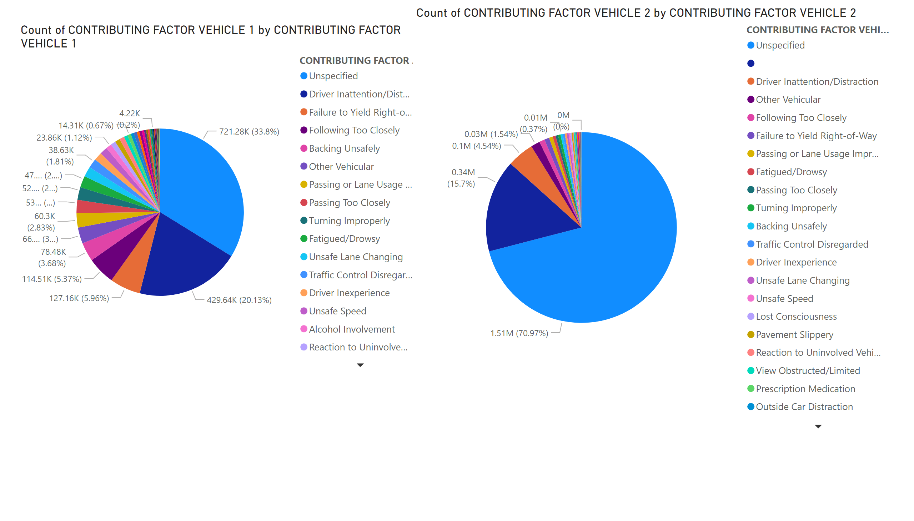
Pie charts
Notes:
pieChart
No alt text provided
pieChart
No alt text provided

Slide 3
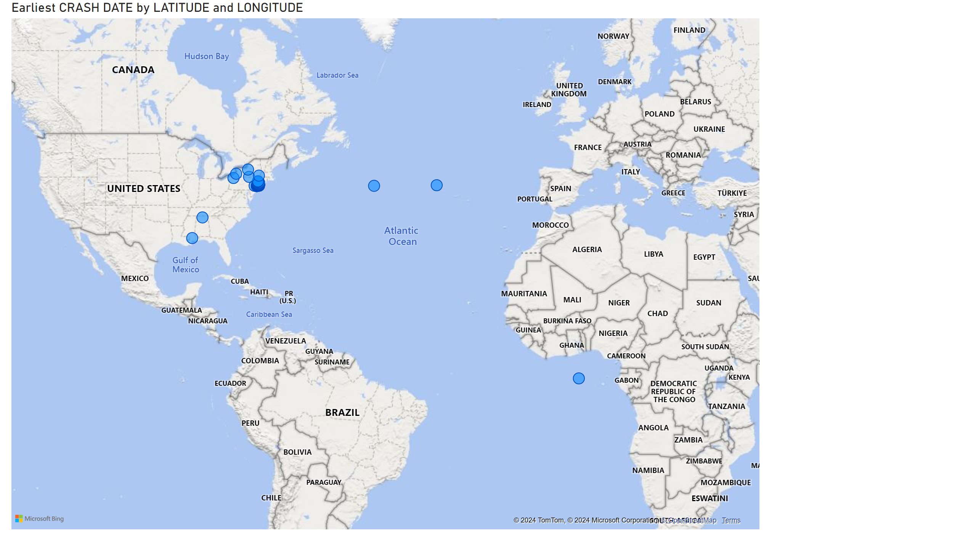
Map
Notes:
map
No alt text provided

Slide 4
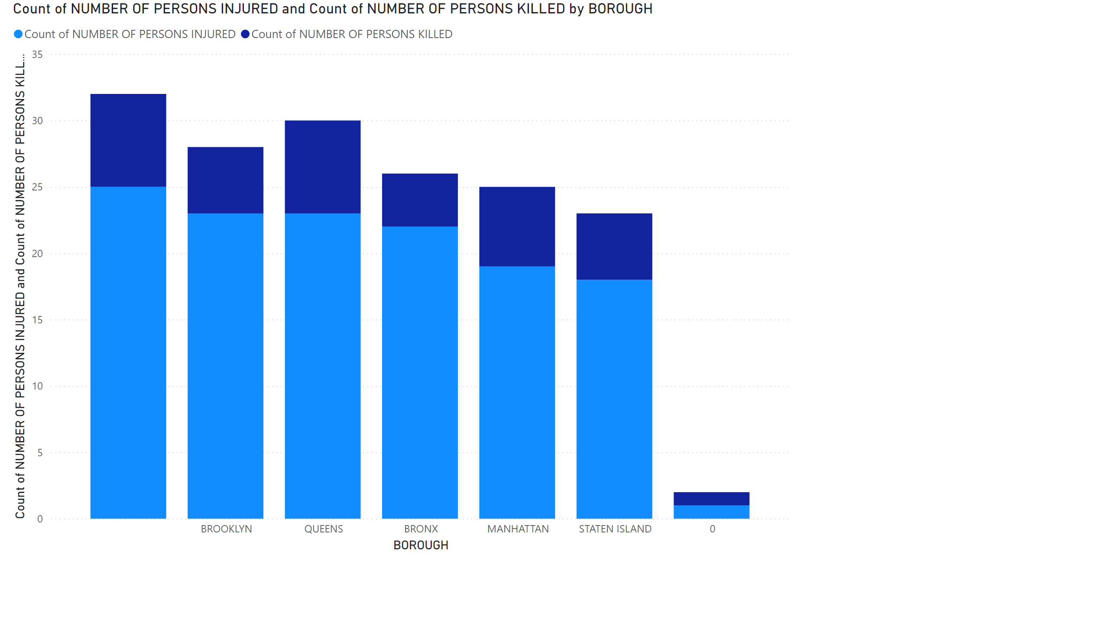
Bar charts
Notes:
columnChart
No alt text provided

Slide 5
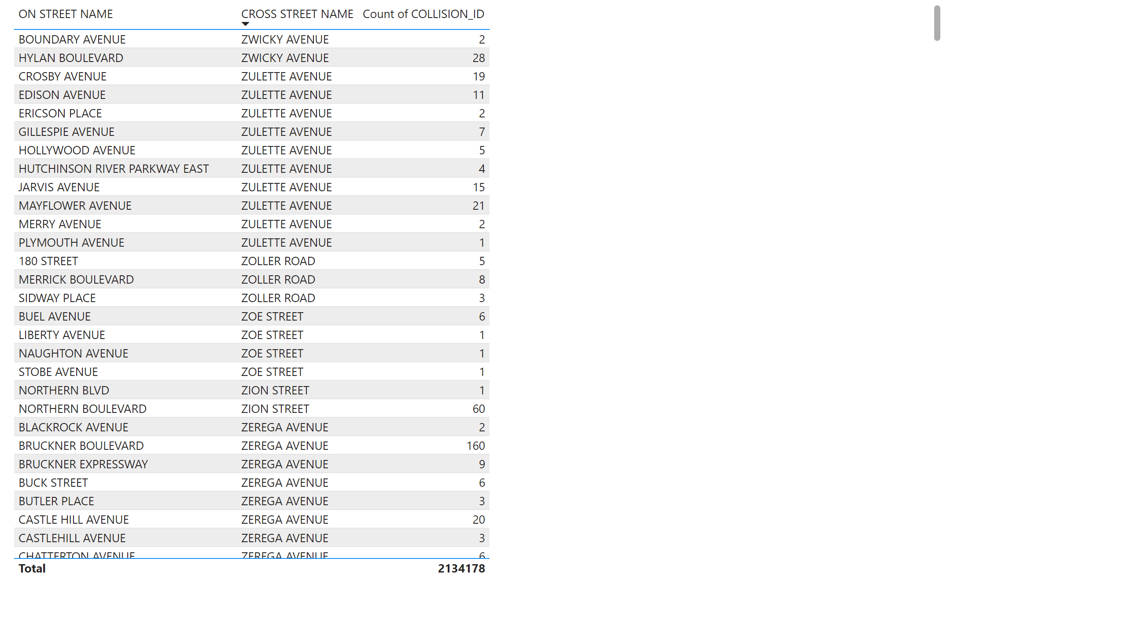
Table
Notes:
tableEx
No alt text provided

Slide 6
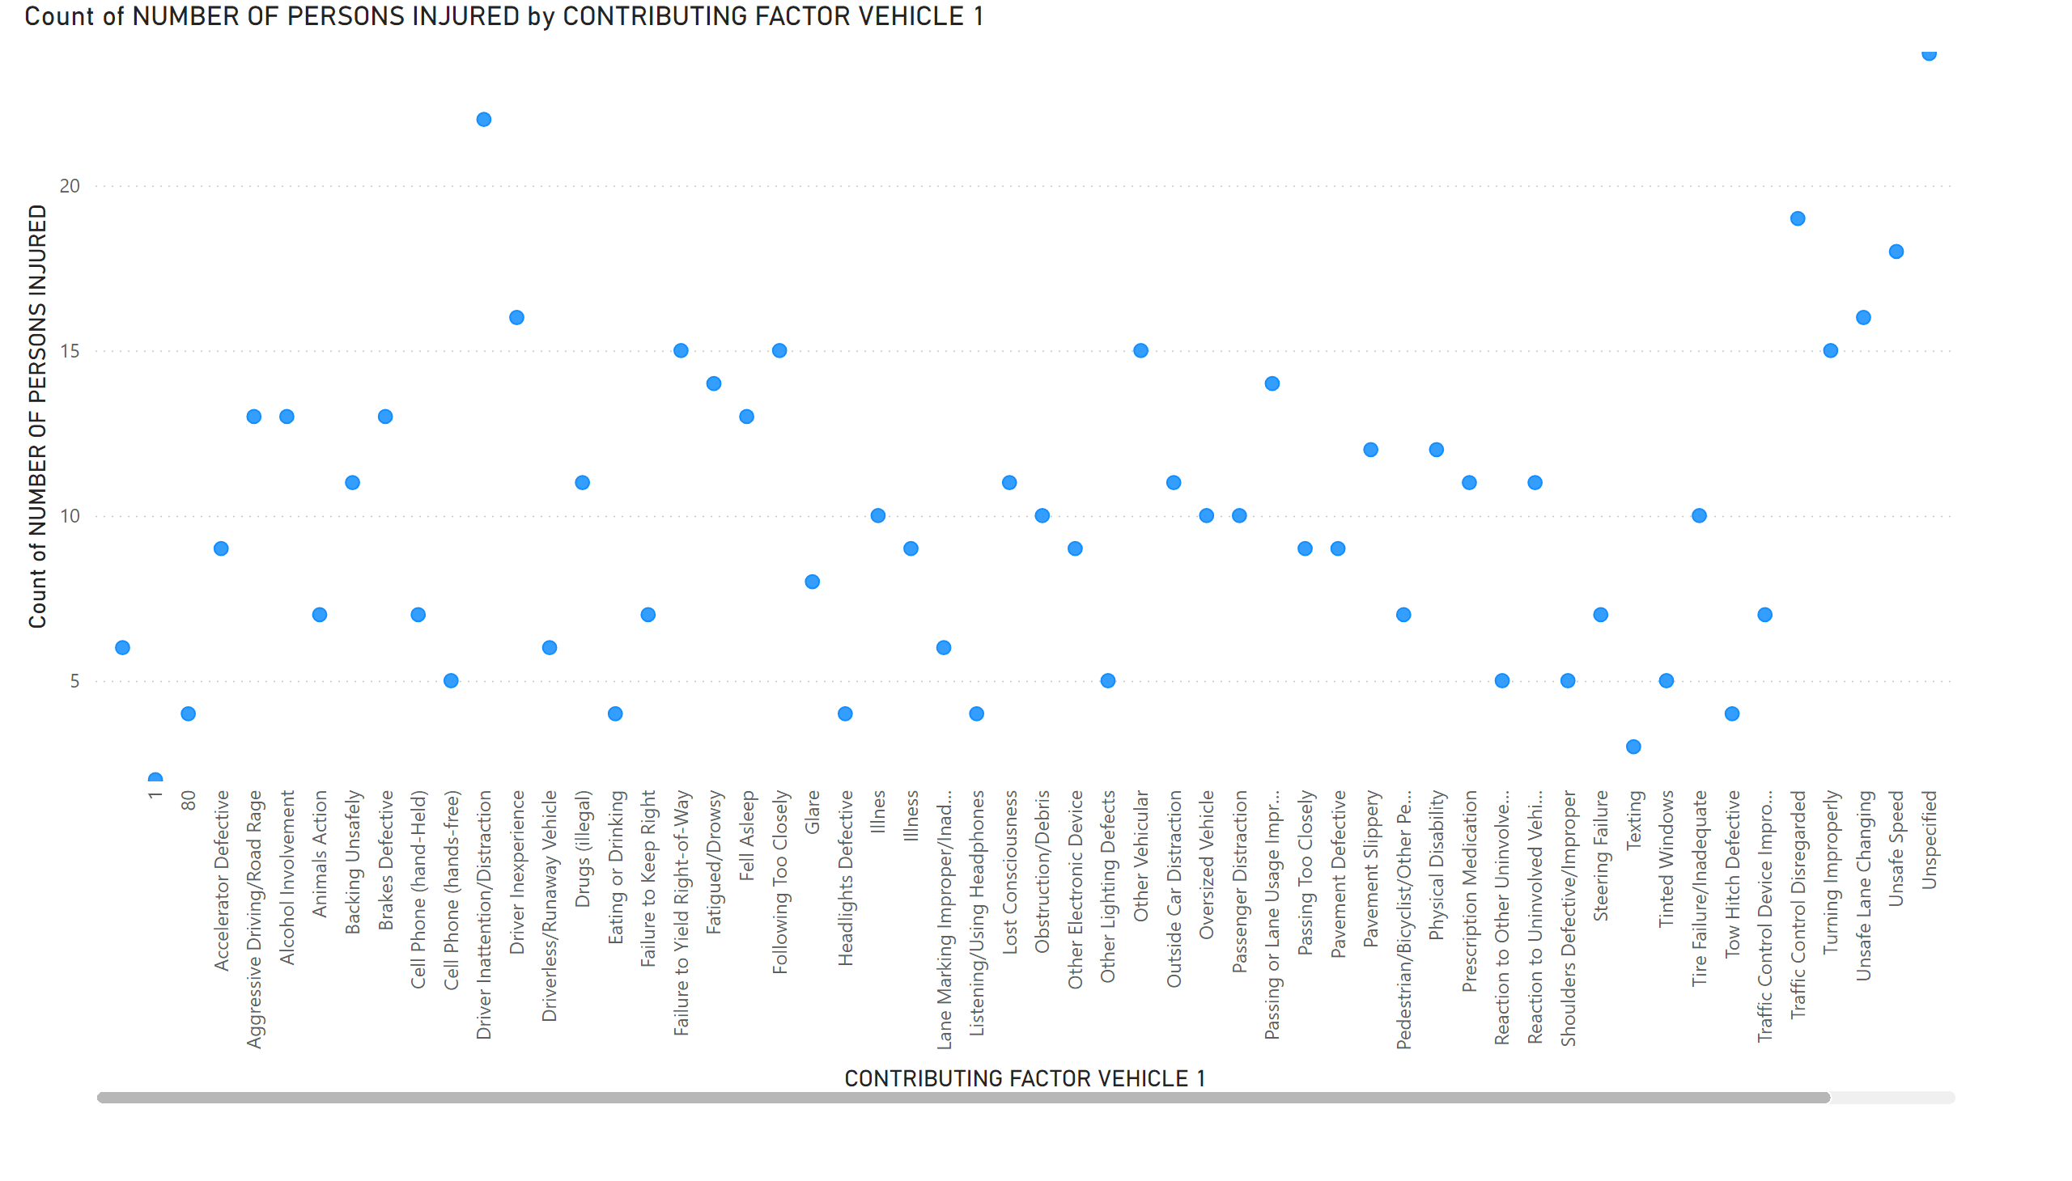
Scatter
Notes:
scatterChart
No alt text provided

